Slide 1





Superconductor Quantum Computing
Tamer Abuelfadl August 5, 2025

Slide 2


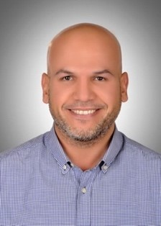


About the Wireless Intelligent Networks Center (WINC)
WINC Research Groups
Wireless and Optical Communications
Radiation and Propagation
Quantum Computing and Quantum Physics
Holography and 3D Imaging Prospective
Prof. Ahmed Hazem El Mahdy
Prof. Salem Hegazy
Prof. Iman Abolmaaly
(Visiting Professor from
Khartoum University)
Mohamed Hossam

Slide 3
Group Research Tracks
Superconductor Quantum Computing
Quantum Circuits (Field Quantization)
Josephson Junction and SQUID (superconducting quantum interference device)
Parametric Amplifier using JJ (Josephson Junction)
Optical Quantum Computing
Quantum Optics
Linear Optics for Quantum Computing
Quantum Algorithm
Quantum Variational Circuit
Quantum Neural Network

Slide 4
Superconductor Quantum Computer
Classical realm Vs Quantum realm
Alice in Quantum Land
LC oscillator, and quantization
Josephson Junction and Anharmonicity
Control Gates of Superconductor Qubit.
Measuring Superconductor Qubit.

Slide 5
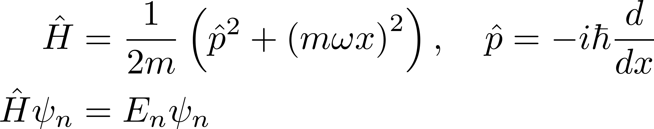
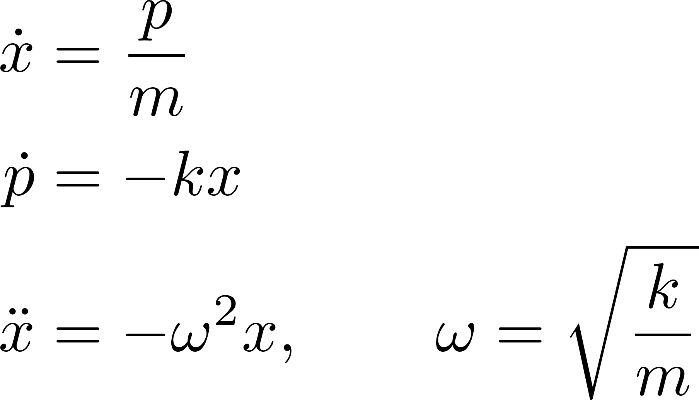
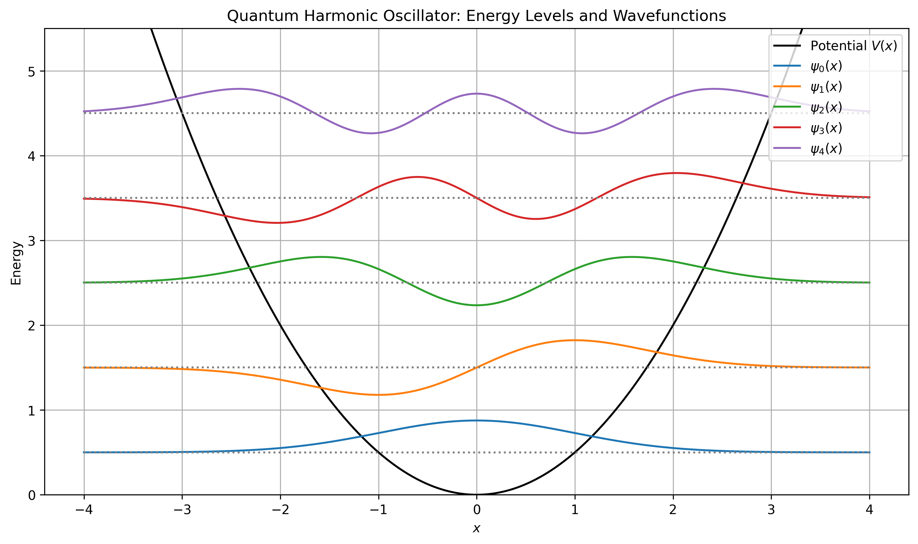
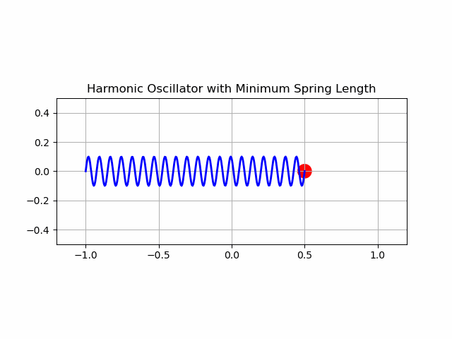
Classical realm Vs Quantum realm
Classical Spring Oscillator: mass m attached to spring with force constant k
Quantum Hamiltonian

Slide 6
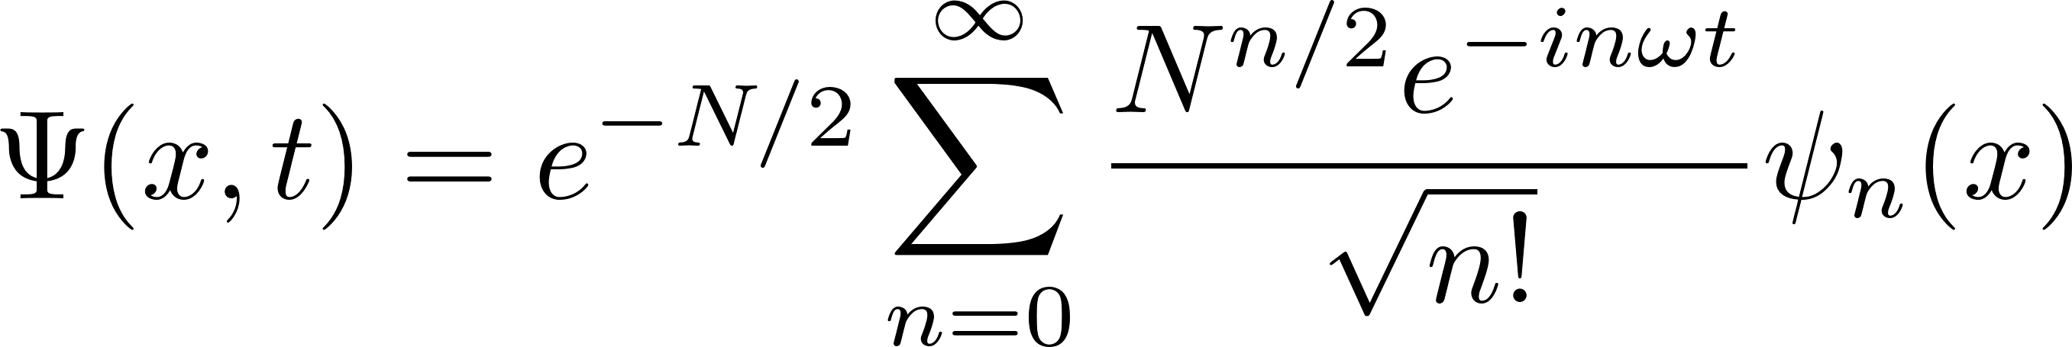
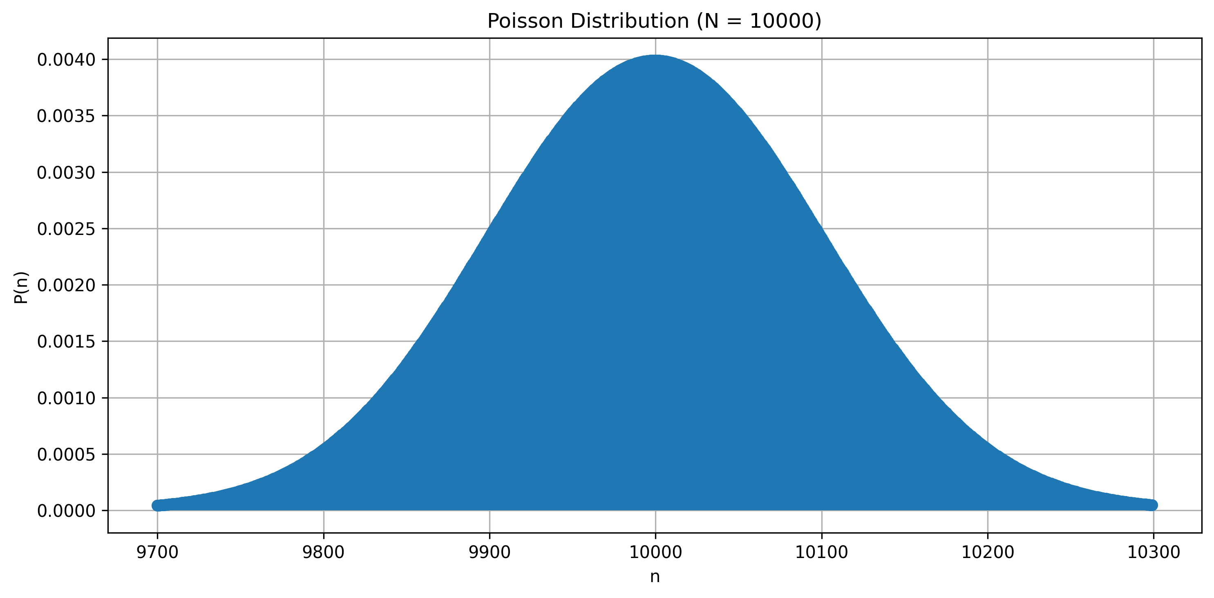
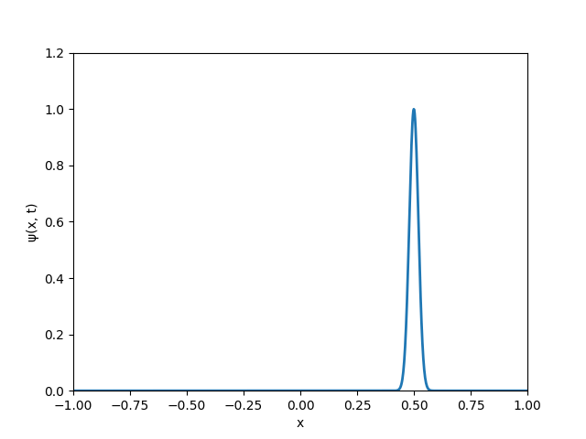
Quantum Harmonic Oscillator
Coherent State “Classical State”
Stationary States

Slide 7
Coherent State “Classical State”

Slide 8
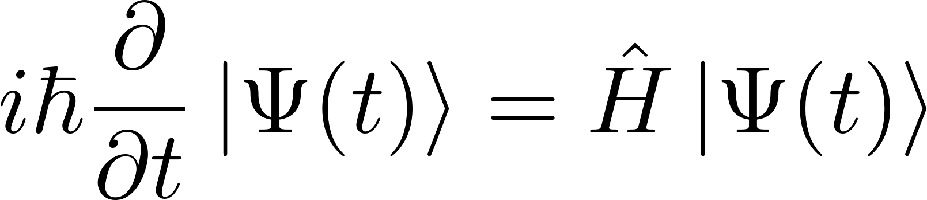
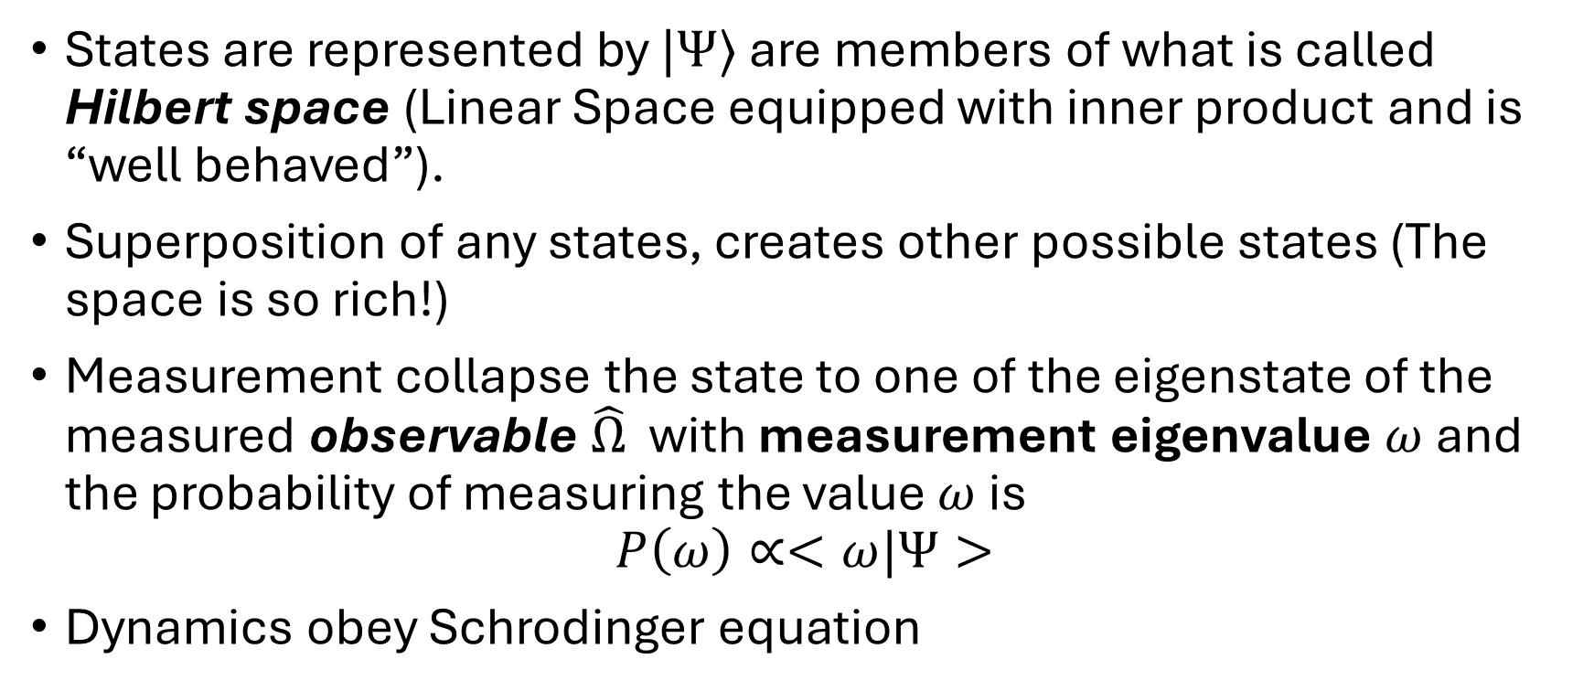
Postulates of Quantum Mechanics
States are represented by $|Ψ⟩$ are members of what is called Hilbert space (Linear Space equipped with inner product and is “well behaved”).
Superposition of any states, creates other possible states (The space is so rich!)
Measurement collapse the state to one of the eigenstate of the measured observable $\hat{Ω}$ with measurement eigenvalue $ω$ and the probability of measuring the value $ω$ is
$$P\left(ω\right)∝<ω|Ψ>$$
Dynamics obey Schrodinger equation

Slide 9

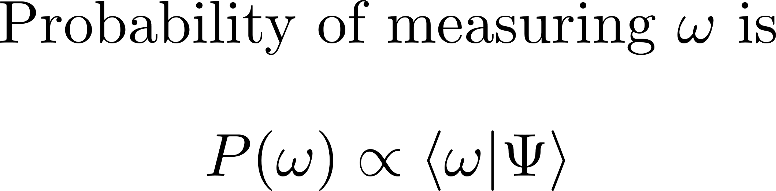




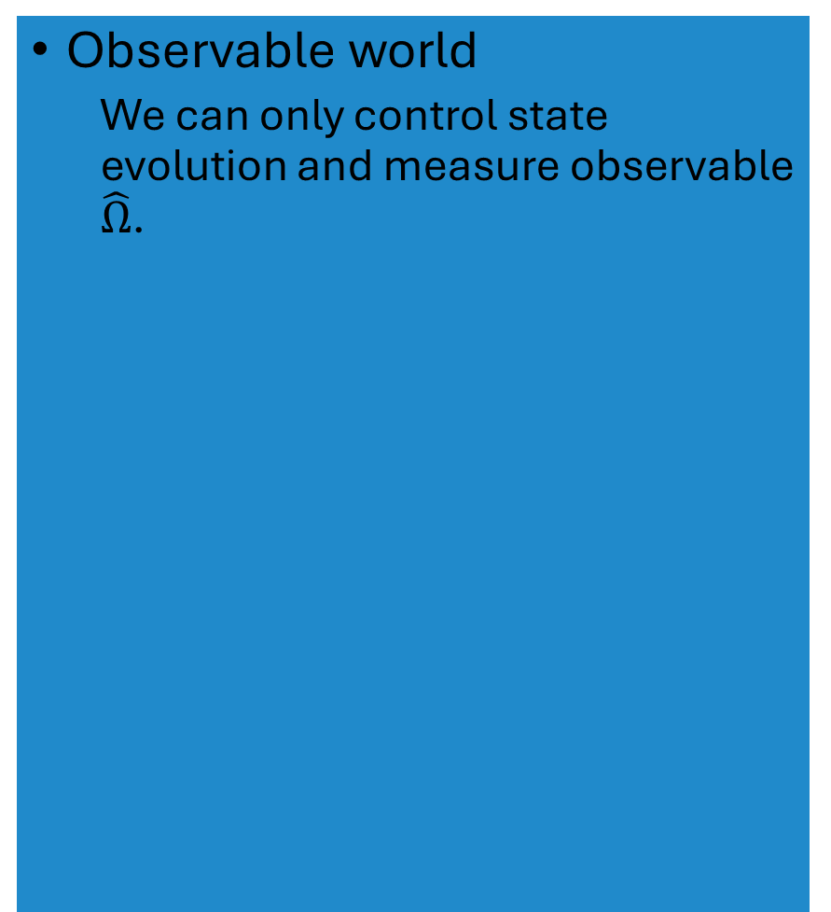
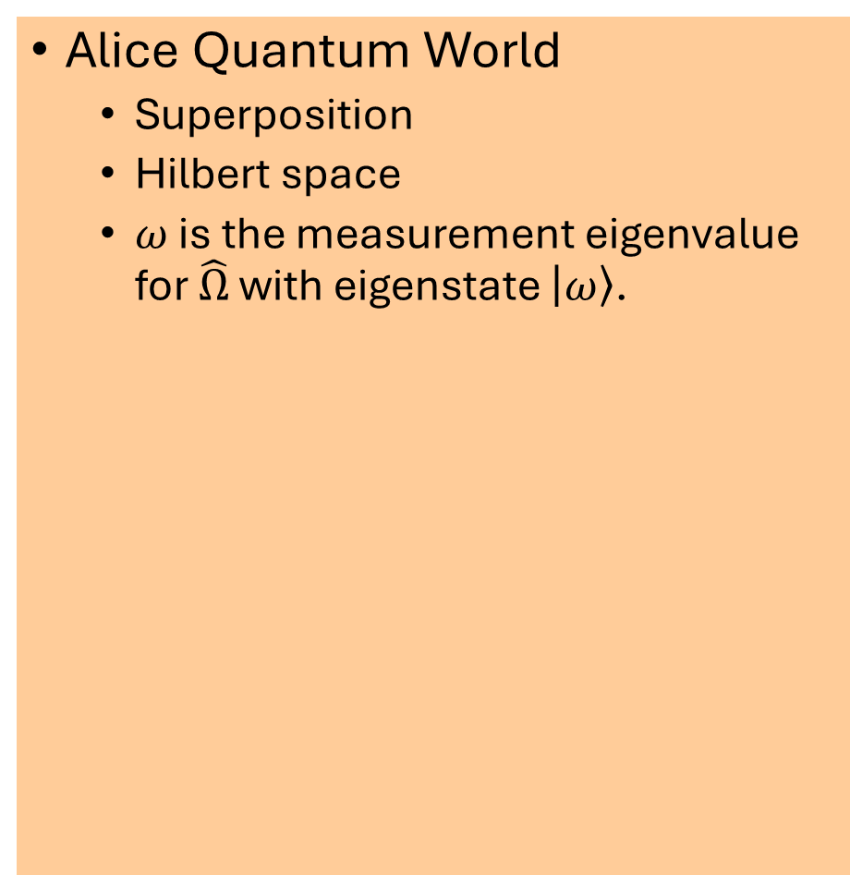

Alice Quantum World
Observable world
We can only control state evolution and measure observable $\hat{Ω}$.
Alice Quantum World
Superposition
Hilbert space
$ω$ is the measurement eigenvalue for $\hat{Ω}$ with eigenstate $\left|ω\right\rangle$.
Measurement result $ω$
Collapse
Measurement $\hat{Ω}$
Control (Modify $\hat{H}$)

Slide 10
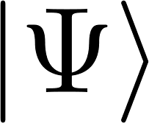


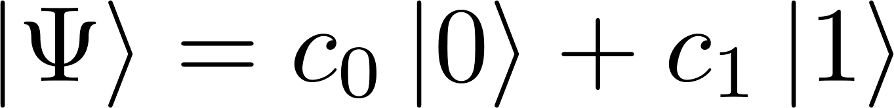
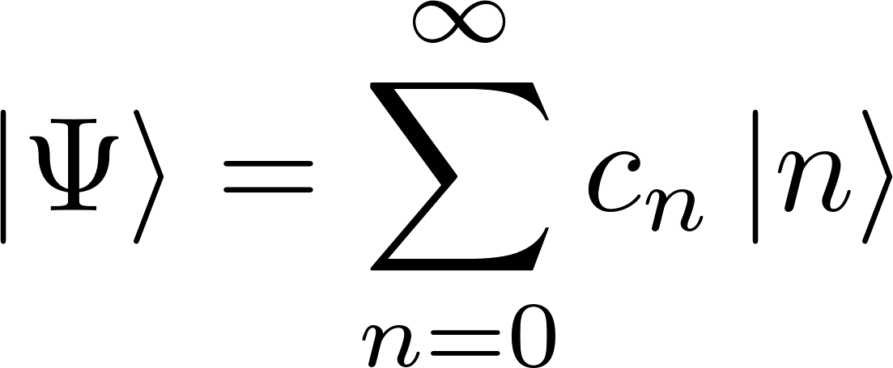

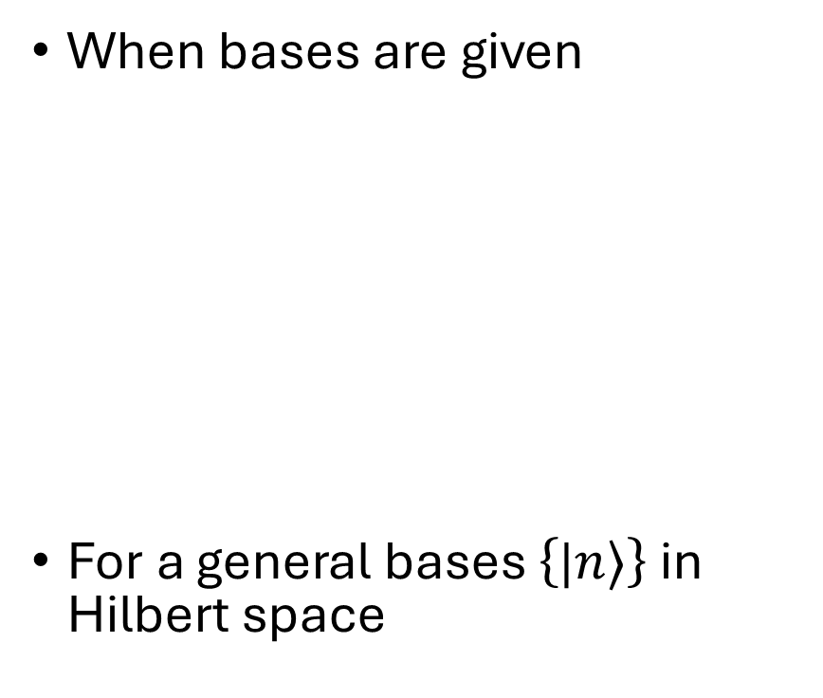
Quantum state $|Ψ⟩$ representation
When bases are given
For a general bases $\left\{\text{|}n⟩\right\}$ in Hilbert space
When no bases are specified
Bases choice mainly depends on the system to be quantized.

Slide 11
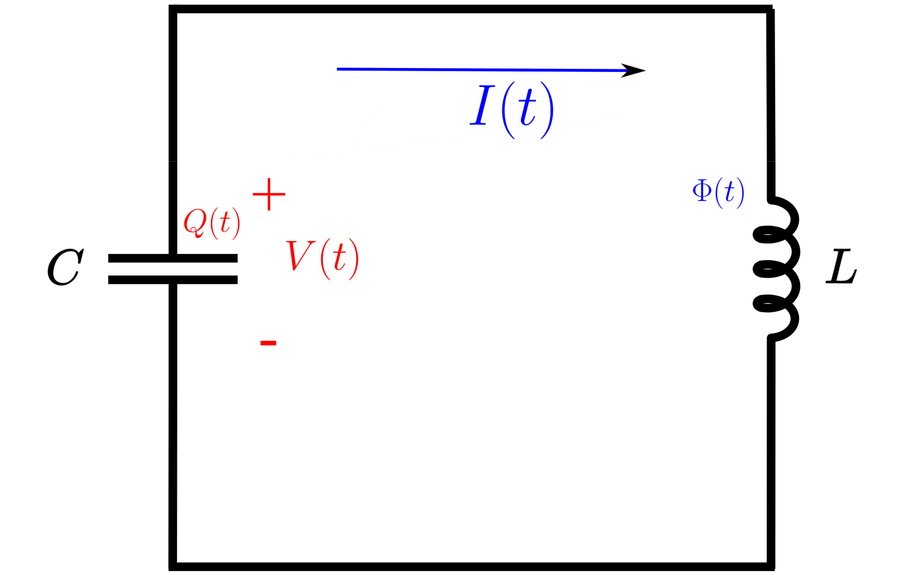
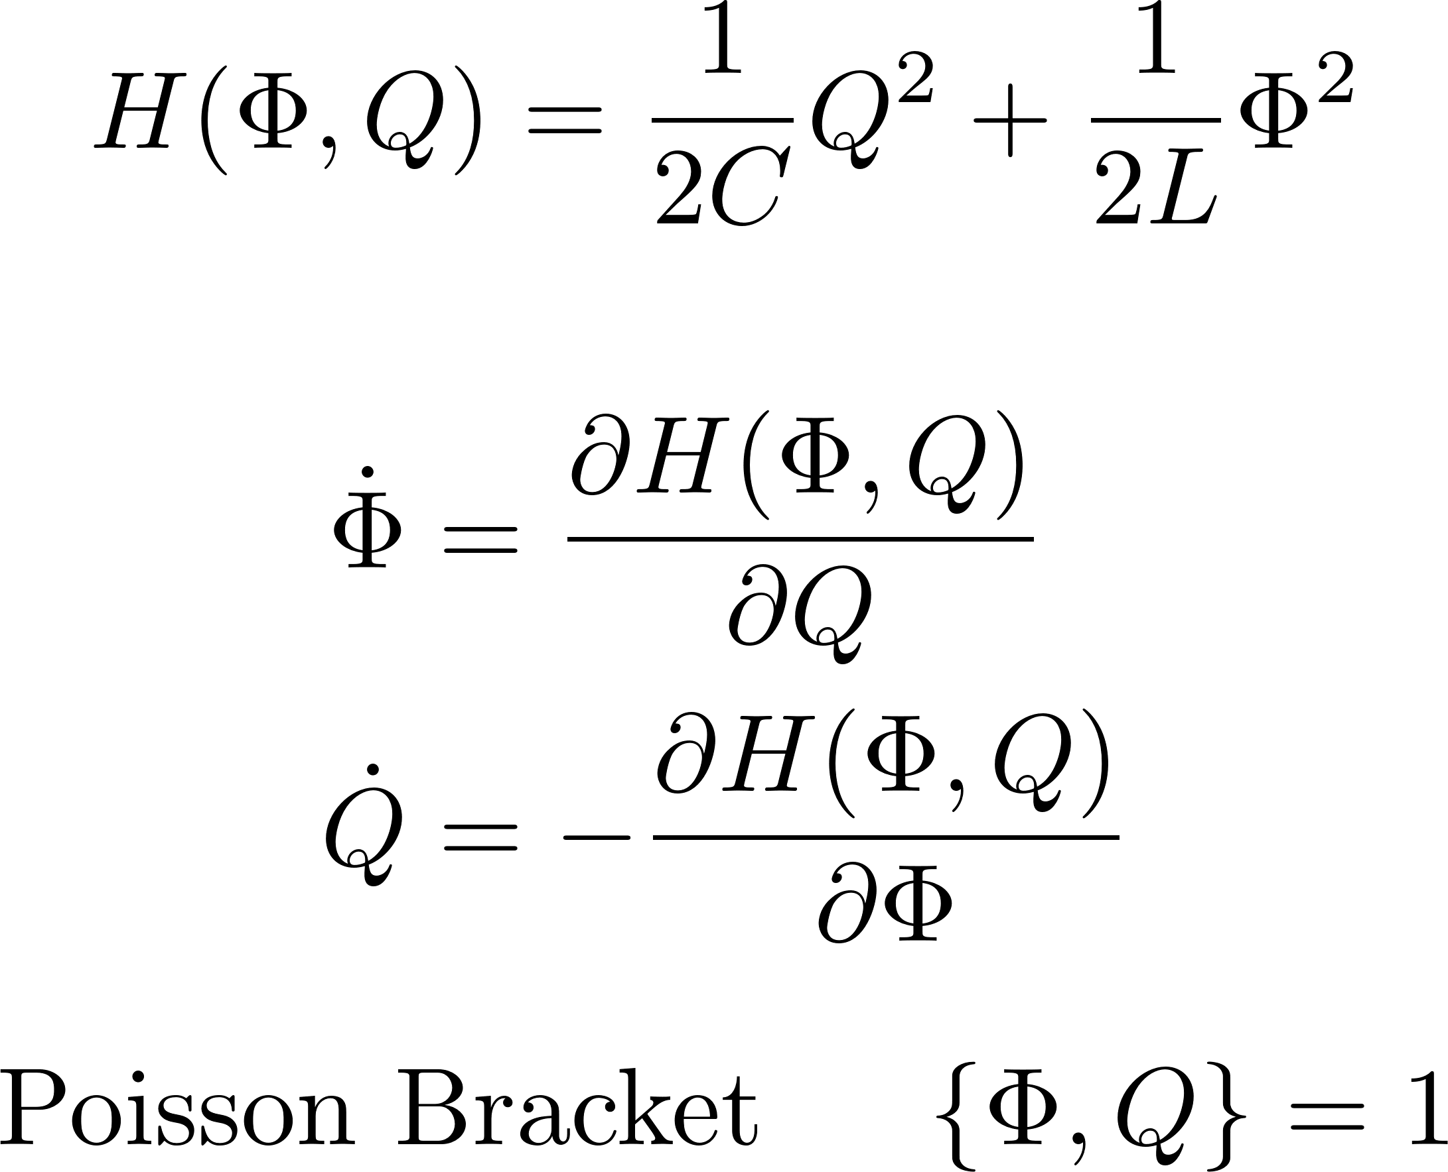
LC oscillator
Charge and flux oscillate like position and momentum in harmonic oscillator.
Energy or Hamiltonian

Slide 12
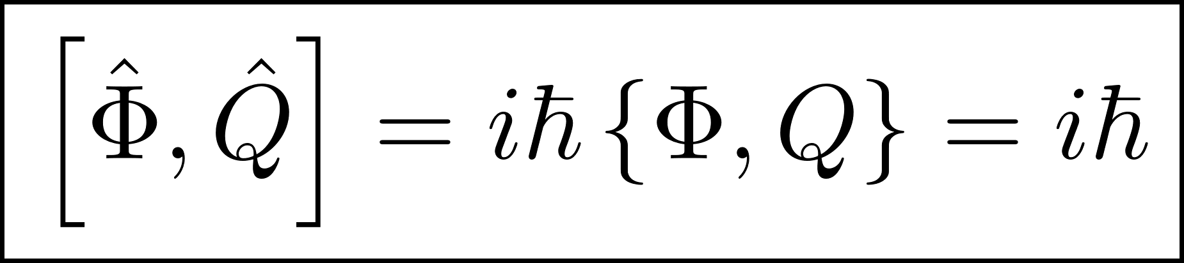
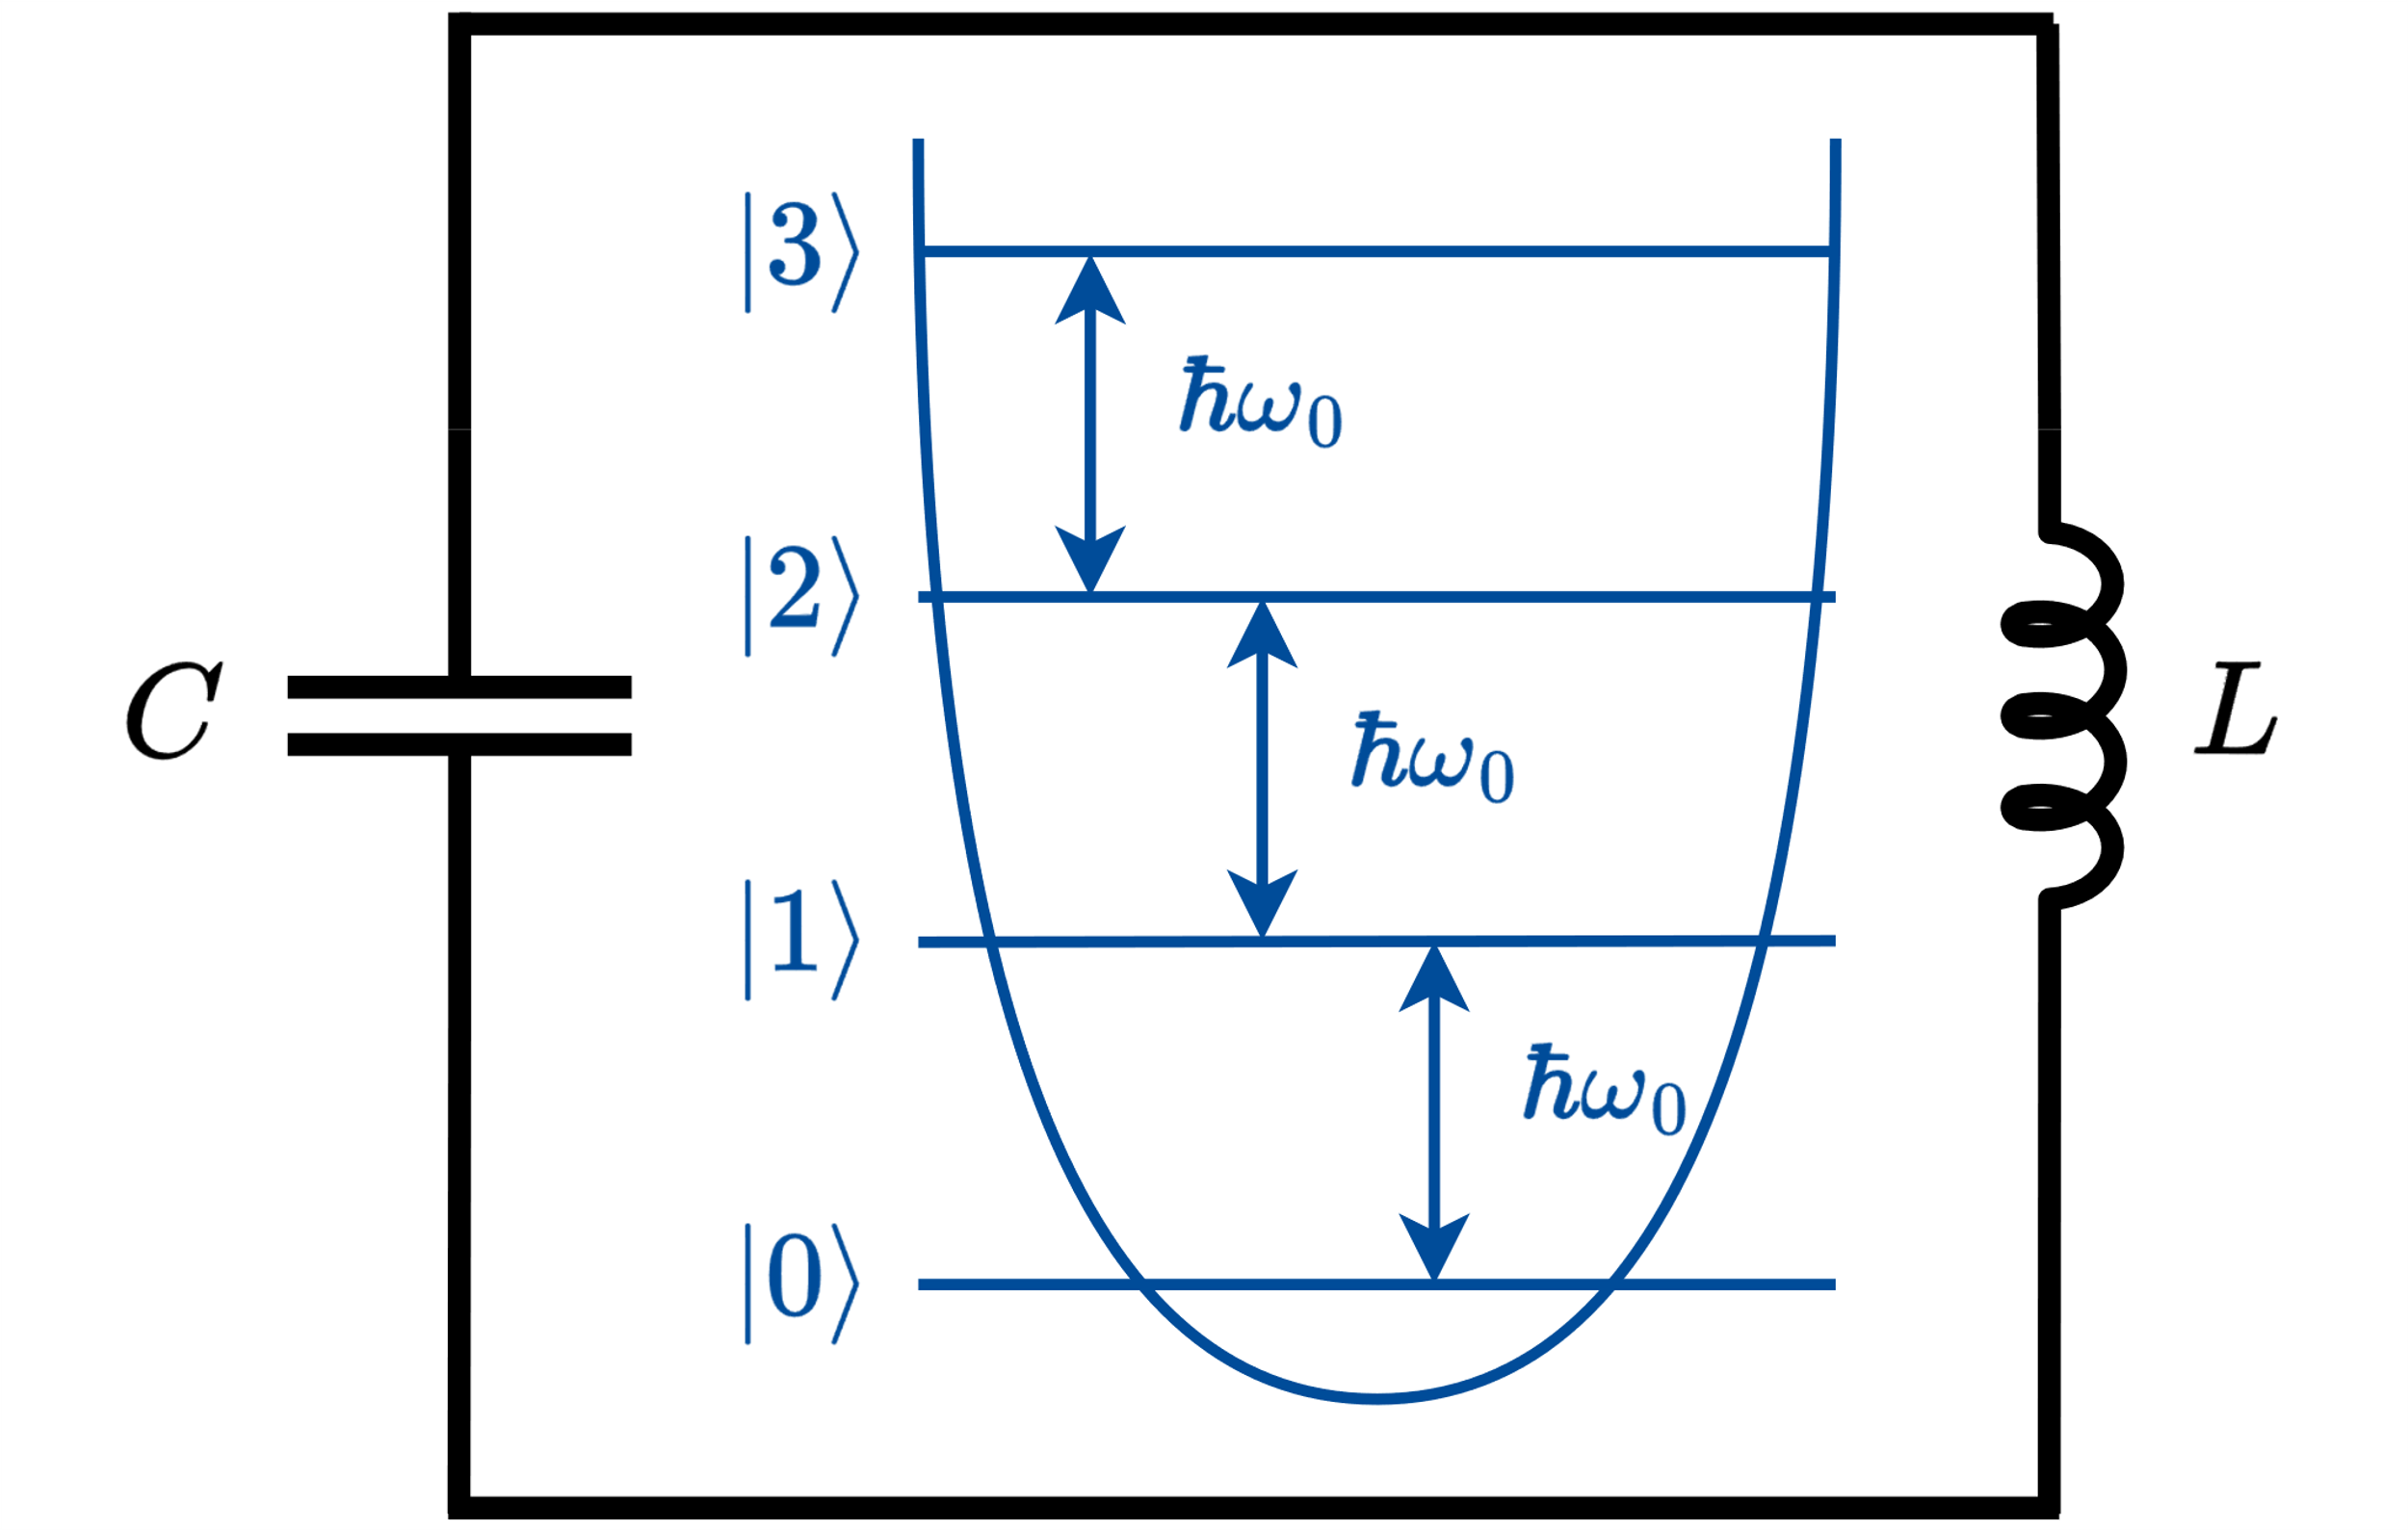
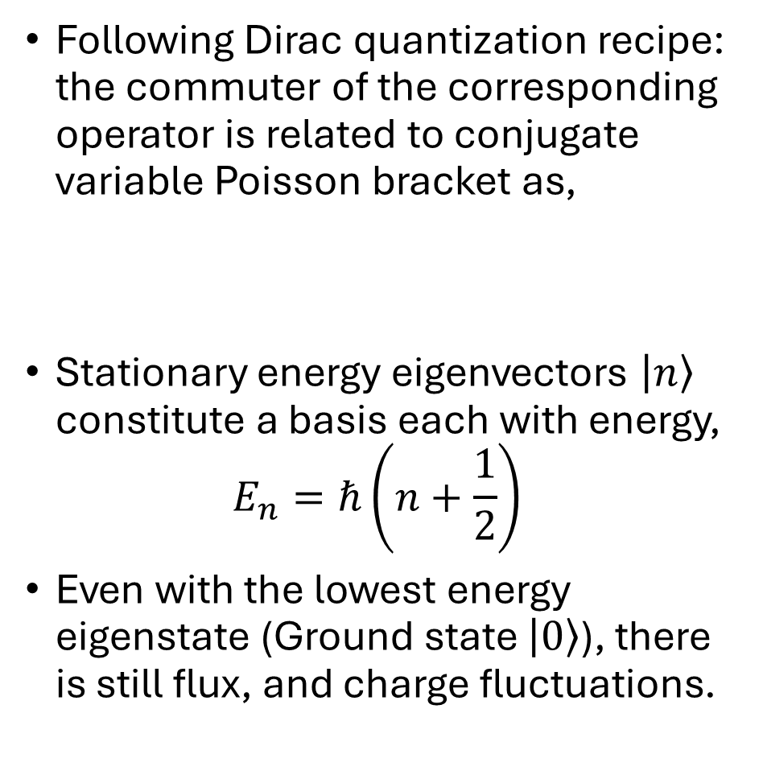
LC Quantization
Following Dirac quantization recipe: the commuter of the corresponding operator is related to conjugate variable Poisson bracket as,
Stationary energy eigenvectors $\left|n\right\rangle$ constitute a basis each with energy,
$$E_{n}=ℏ\left(n+\frac{1}{2}\right)$$
Even with the lowest energy eigenstate (Ground state $\left|0\right\rangle$), there is still flux, and charge fluctuations.

Slide 13
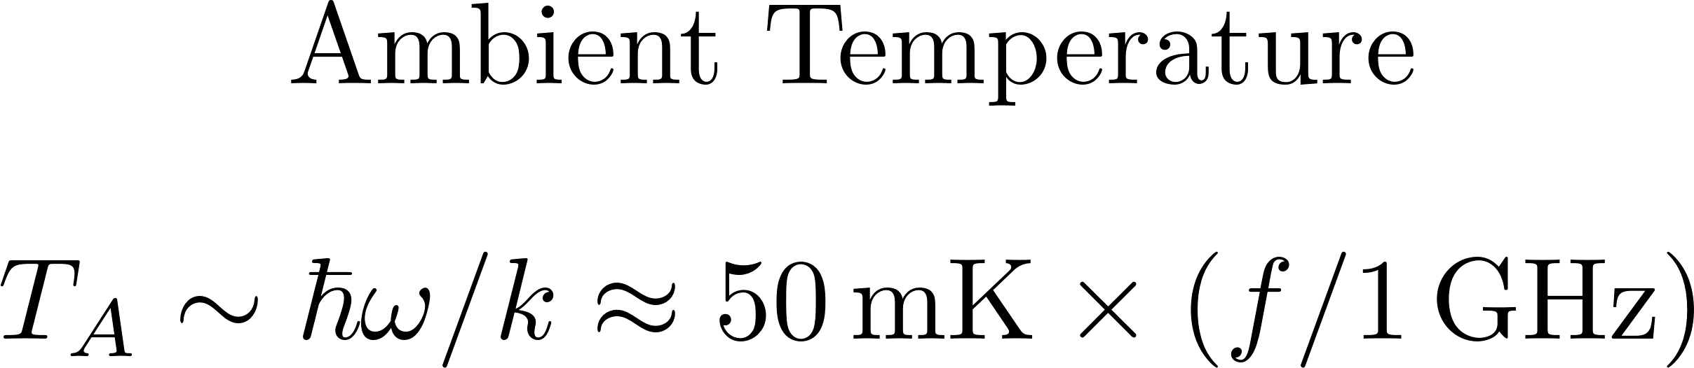
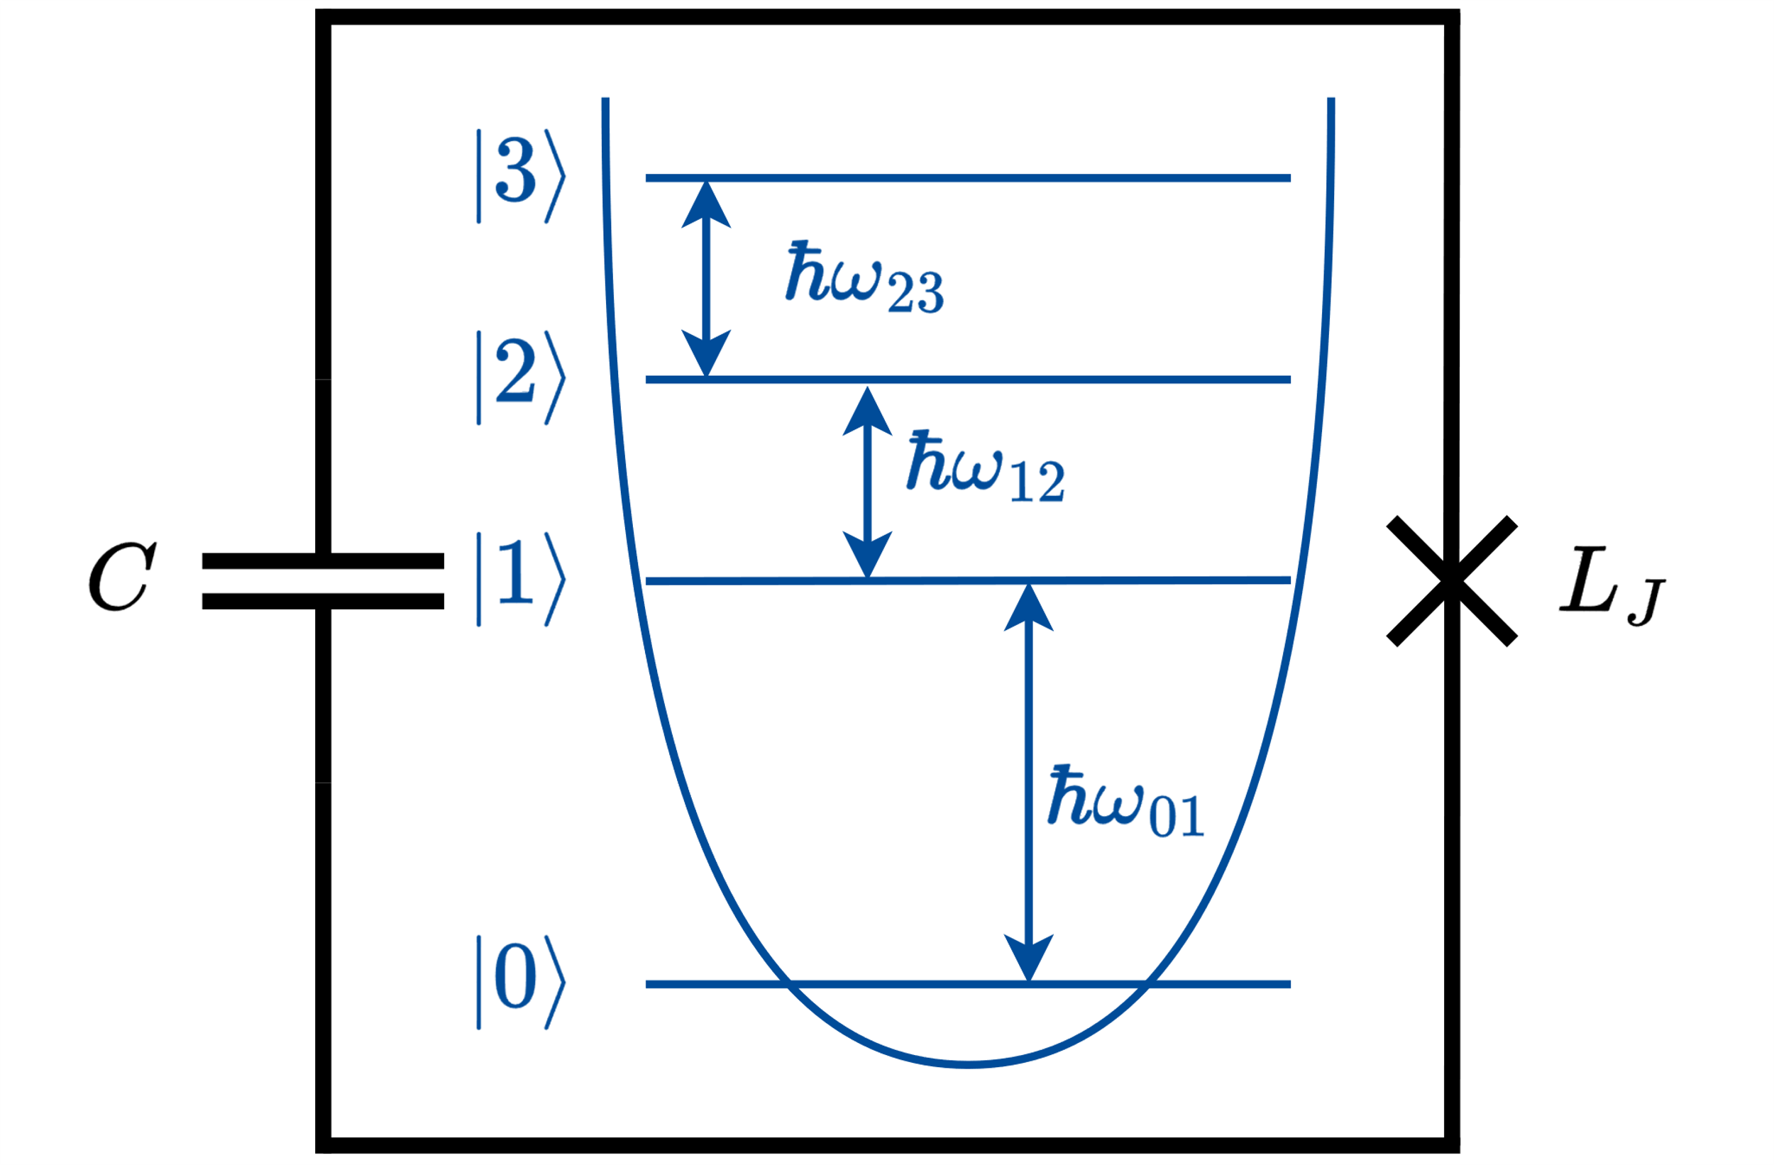
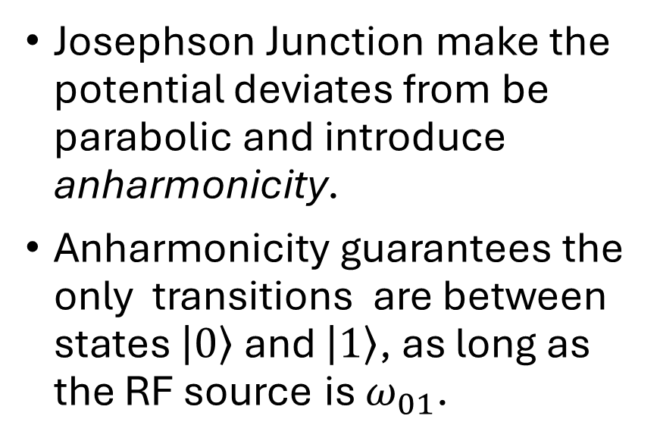
Josephson Junction and Anharmonicity
Josephson Junction make the potential deviates from be parabolic and introduce anharmonicity.
Anharmonicity guarantees the only transitions are between states $\left|0\right\rangle$ and $\left|1\right\rangle$, as long as the RF source is $ω_{01}$.

Slide 14
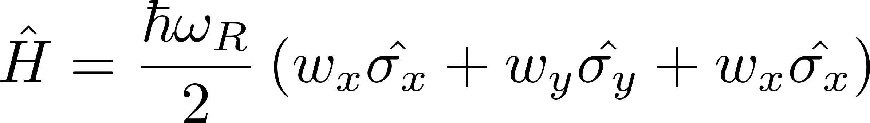
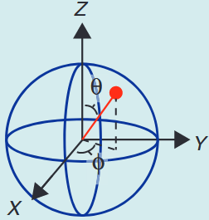
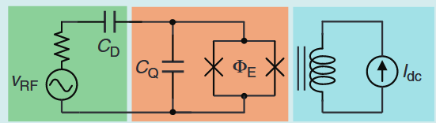
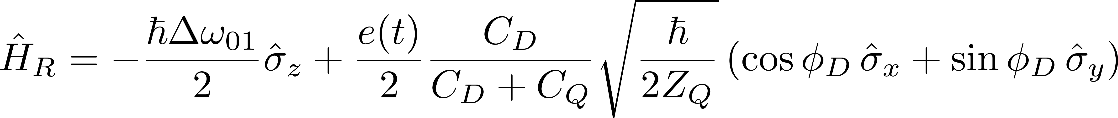
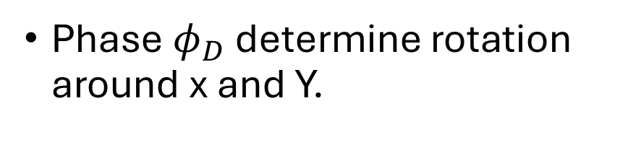
Single Qubit Gate (Control)
Detuning flux in SQUID controls Z-rotation
Phase $φ_{D}$ determine rotation around x and Y.
J. C. Bardin, D. Sank, O. Naaman, and E. Jeffrey, “Quantum Computing: An Introduction for Microwave Engineers,” IEEE Microwave, vol. 21, no. 8, pp. 24–44, Aug. 2020, doi: 10.1109/MMM.2020.2993475.

Slide 15
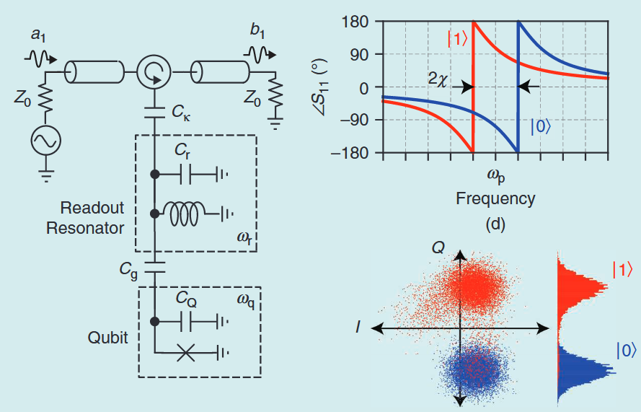
Measurement (Readout)
J. C. Bardin, D. Sank, O. Naaman, and E. Jeffrey, “Quantum Computing: An Introduction for Microwave Engineers,” IEEE Microwave, vol. 21, no. 8, pp. 24–44, Aug. 2020, doi: 10.1109/MMM.2020.2993475.

Slide 16
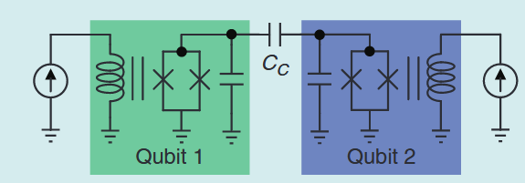
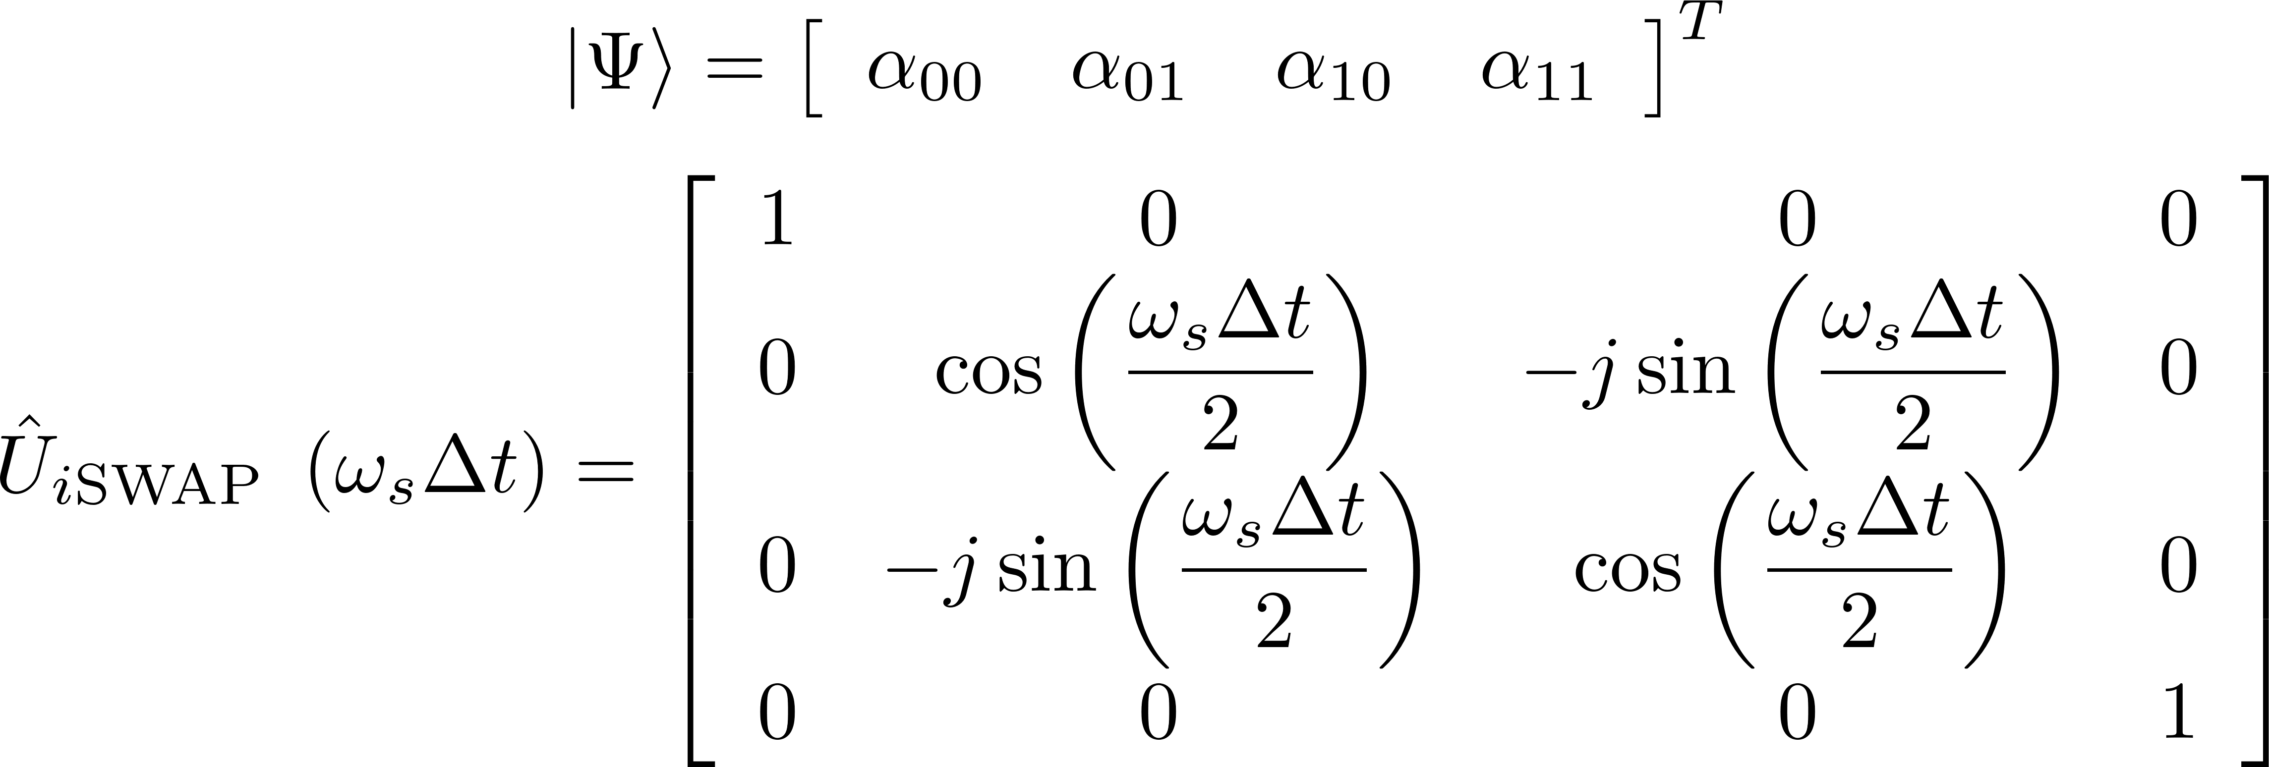
Two Qubits Gates
J. C. Bardin, D. Sank, O. Naaman, and E. Jeffrey, “Quantum Computing: An Introduction for Microwave Engineers,” IEEE Microwave, vol. 21, no. 8, pp. 24–44, Aug. 2020, doi: 10.1109/MMM.2020.2993475.

